Slide 1


1
Advanced Formula Knowledge & VLOOKUP
Presented by: Data Team

Slide 2
Advanced Formula in Excel
Conditional Math & Statistics Functions
Vlookup with Approximate Match
Vlookup with Exact Match
Formula Auditing Trace precedence and dependence

Slide 3
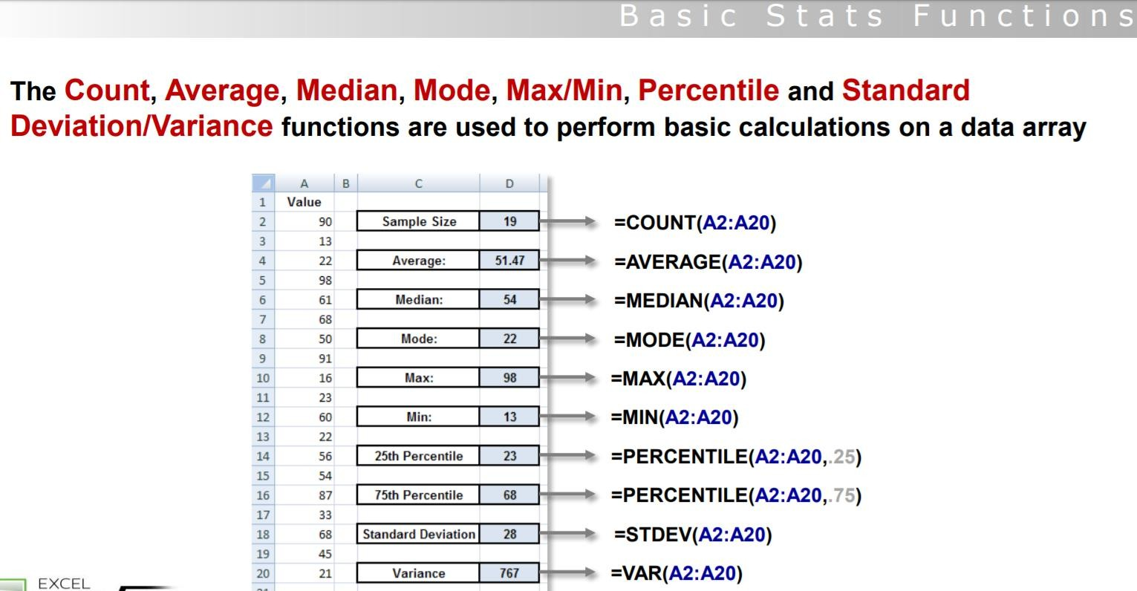
Conditional Math/Stats Functions

Slide 4
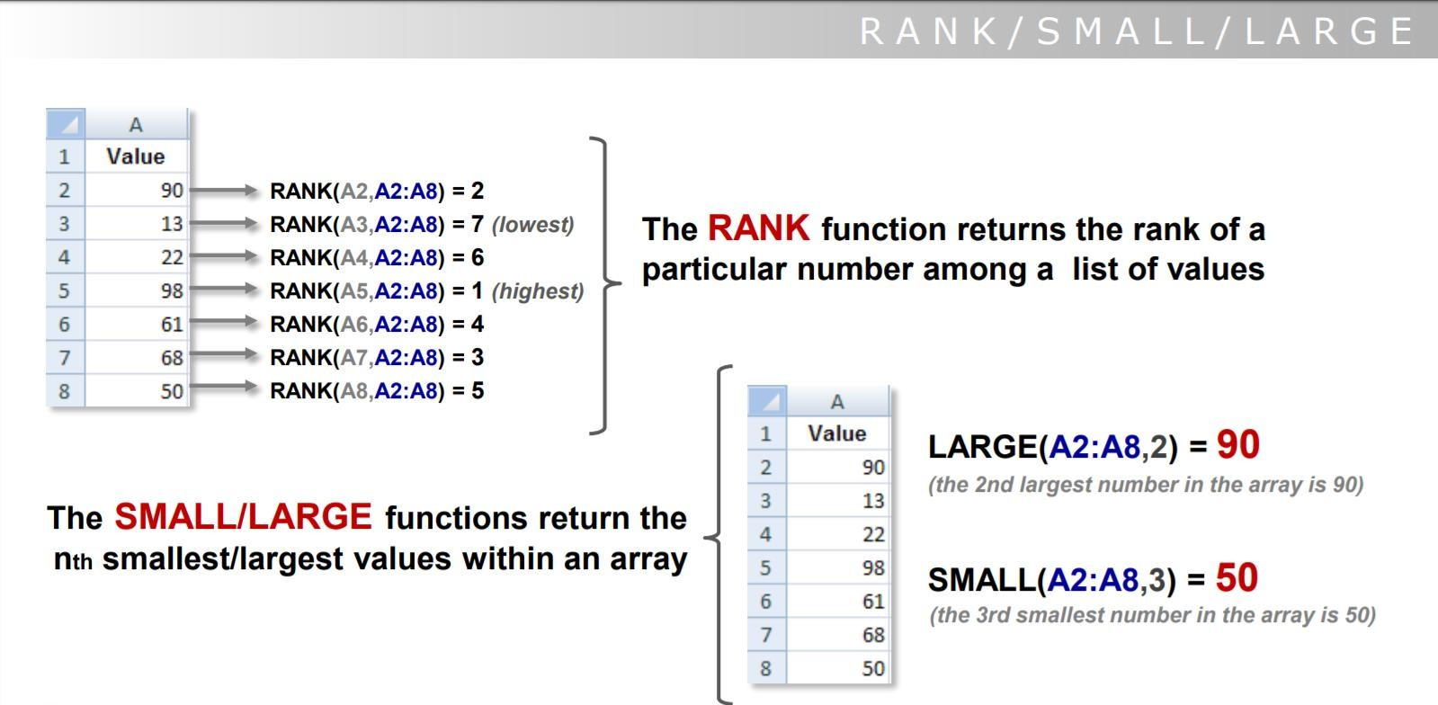
Conditional Math/Stats Functions

Slide 5
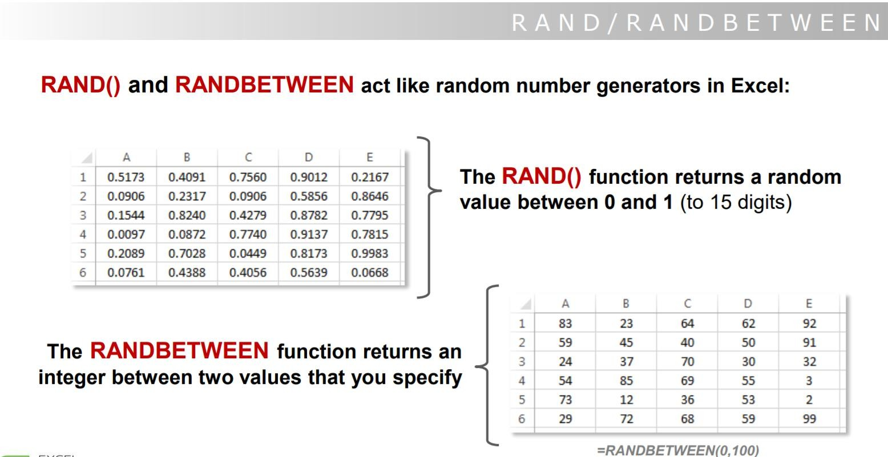
Conditional Math/Stats Functions

Slide 6
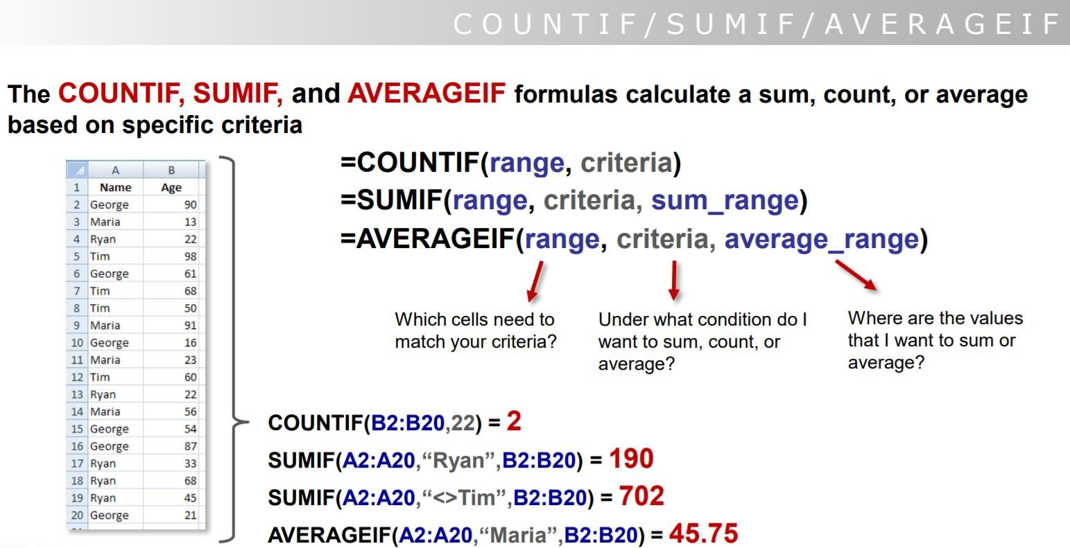
Conditional Math/Stats Functions

Slide 7
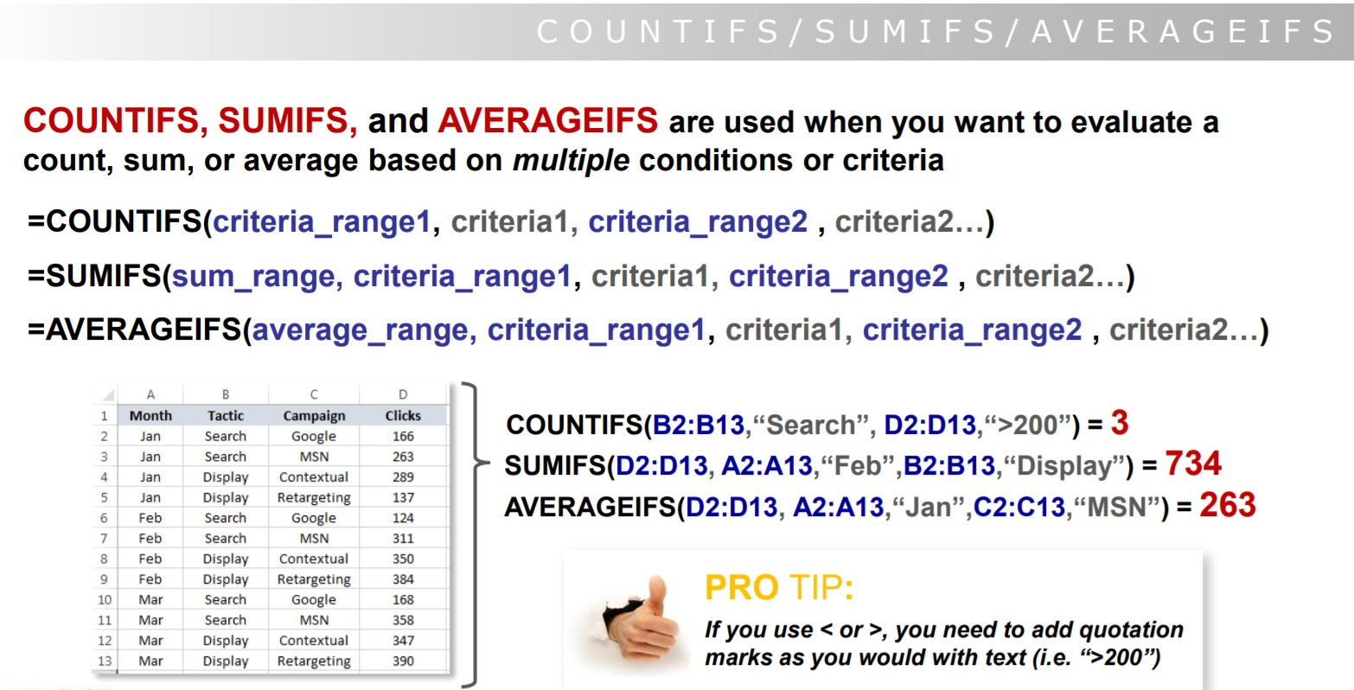
Conditional Math/Stats Functions

Slide 8
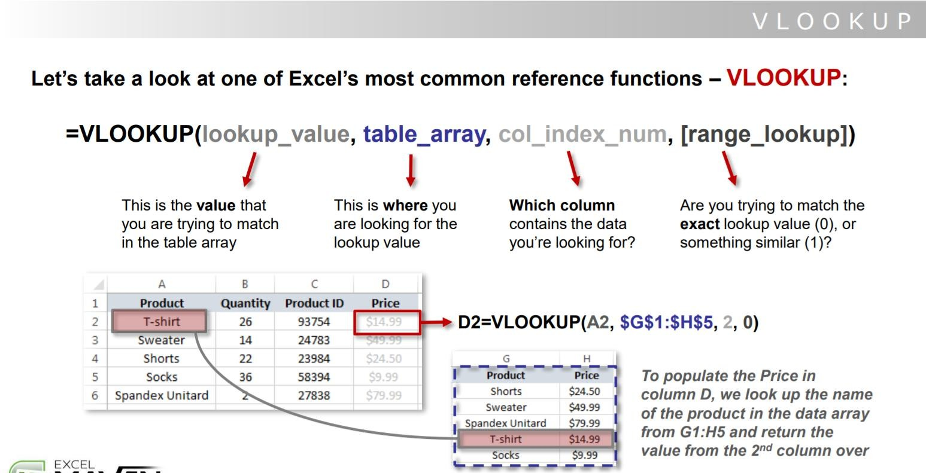
Lookup References

Slide 9

Lab session

Slide 10


Thank You

